Slide 1
Open Pyrojet – MultiPyroJet
FDM printer modified to print metal, ceramic and high temperature plastics, with enhanced resolution, automation, control and speed.

Slide 2
Basic System Layout
Peristaltic Pump
Material Suspension Tank
(0.5-30 micron powder in Ethanol/other fuel)
Fuel+Material Flow
To Print Head
Fuel+Material Flow
From Print Head
FR4 Perf board 0.05” (1.27mm pitch)
Combustion of Air+Fuel
Silicon Carbide Wire
FR4 Nozzle plate 0.05” (1.27mm pitch)
Flame spray
Build Plate

Slide 3
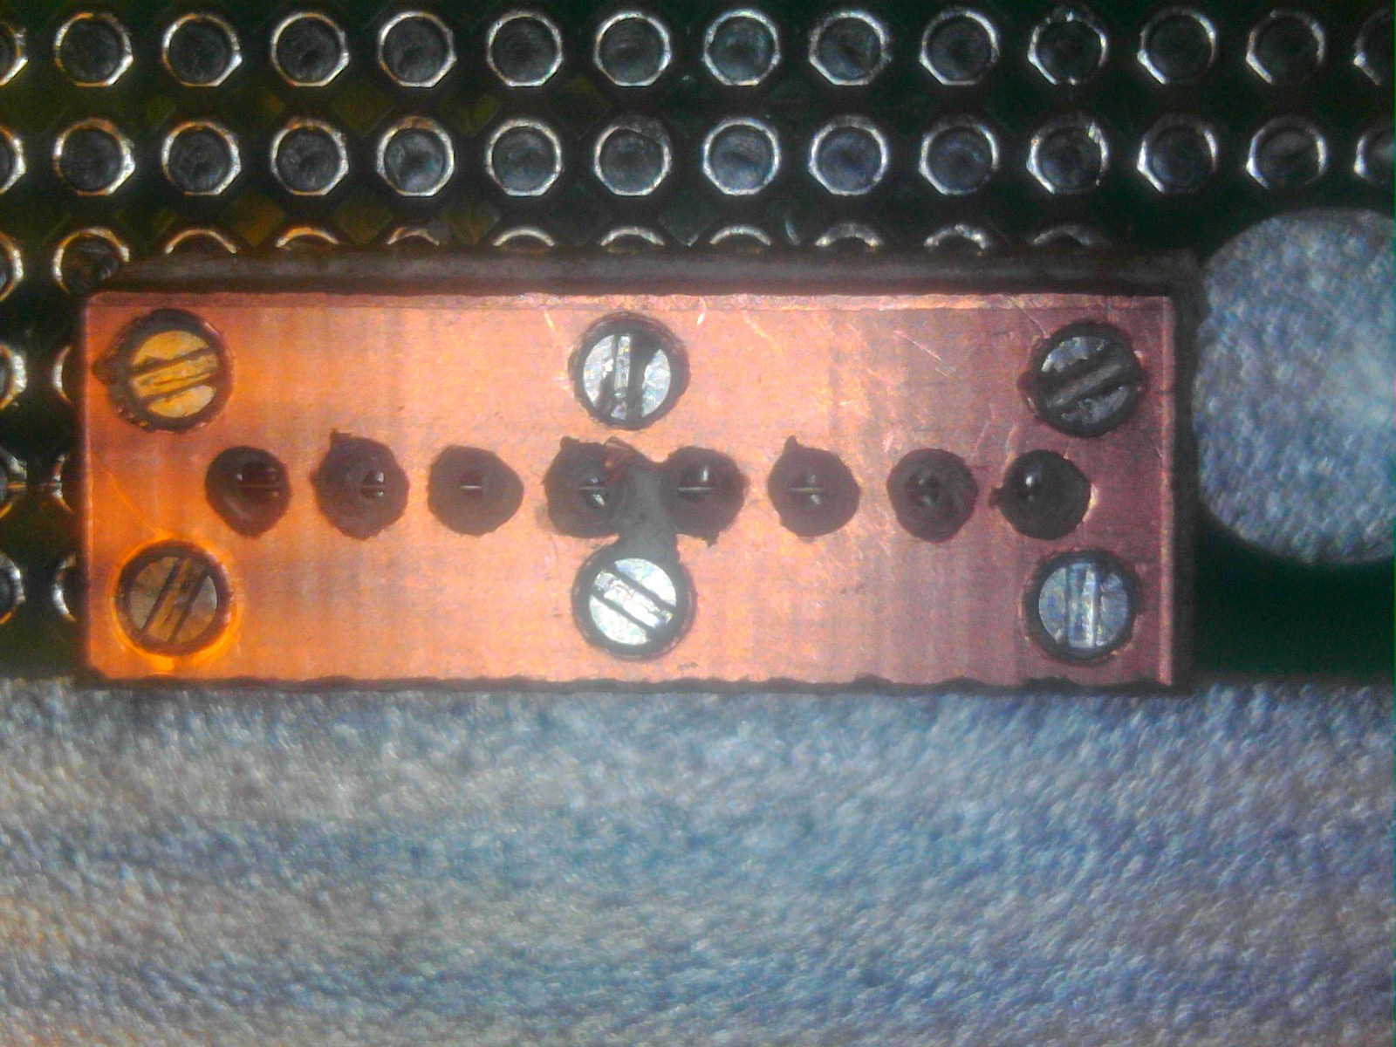
Print Head Detail
1.27 mm Perf Board
0.65mm diameter hole, 1mm pad diameter
The print head is made with an FR4 pefboard as the backplate, serving as electrical connection and mechanical support to a silicon carbide wire. This wire, once mechanically clamped across the plated through holes in the perfboard, via compression by a milled FR4 copper clad nozzle plate, acts as a heating element that ejects fuel and material through the milled nozzles.
CNC milled copper clad FR4 nozzle plate
Silicon Carbide Wire
0.3mm Nozzle
M0.6X4mm Screw

Slide 4
Basic System Description_MultiPyrojet-
Fuel and material are held in a reservoir, kept mixed and pumped in and out by a single peristaltic pump. This peristaltic pump pushes fuel, and suspended material particles to the print head from the back through the perfboard holes. The fuel and material mixture circulate over the top of the print head at a constant average velocity to produce a negative pressure and prevent leakage from the print head.
When the time comes to deposit material on the build plate, a short voltage pulse of controlled amplitude is applied to the captive silicon carbide wire, across two adjacent plated through vias in the perfboard. This causes the wire to rapidly heat up, vaporizing the fuel and entraining the suspended material.
Once an appropriate volume of fuel and material has been vaporized into the nozzle, a second, larger amplitude voltage pulse is applied, raising the temperature in the nozzle to the autoignition temperature of the fuel/air mixture in the nozzle. This ignites the fuel-air mixture, and melts and accelerates the material to deposit it on the built plate.

